Slide 1


ChatX
Data Privacy and Security
Mariana Bento nº53676

Slide 2
Index
01
02
Application
Functionalities
03
04
Communication
Security
05
06
Demo
Future Work

Slide 3


ChatX
Desktop Application
Java
GUI
JavaFx

Slide 4

Functionalities
01
02
03
Login
Add friend
Start Conversation

Slide 5
Security
Anonymity
Ids instead of names
Diffie Hellman
Generate Symmetric Key
AES256
Cipher and Decipher

Slide 6


Handshake
Name
Request ID
Request ID
Name
Key generation (pub and priv)
Send ID
Send ID
Key generation (pub and priv)
Question ID
True/False
Key exchange

Slide 7
Demo

Slide 8
Future Work
GUI insertion
Message Authentication (HMAC)
Shamir's Secret Sharing and Reconstruct

Slide 9
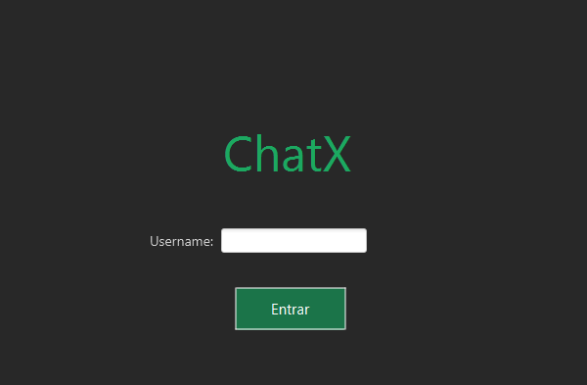

GUI
Login
Chat

Slide 10
Conclusion

